Slide 1

Operating Systems
Designed by Mr. M Mudassar

Slide 2
Outline
Process
Threads
CPU Scheduling
Process Synchronization
Deadlocks
Memory Management
Virtual Memory
File System
I/O System
Disk Management
Protection
Security

Slide 3
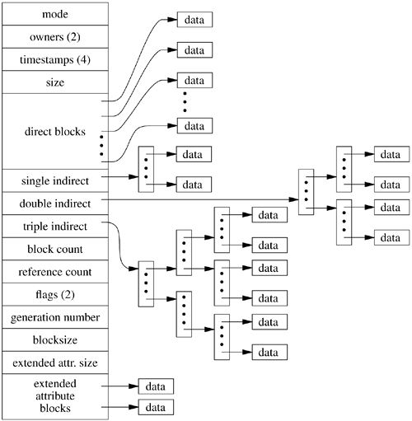
File System (UNIX)
I-Node: it consist of header conditions:

Slide 4

File System (UNIX)
I-Node: it consist of header conditions:
Owner’s identification
Owner’s group identification
Protection bits
Physical address space
File size
Time of creation
Time of last use of the file
Time of last modification to the file
Time of last modification to the I-Node of the file.
No. of links to the file

Slide 5
Thank You(Q & A)

